Slide 1
Preventive medicine in obstetrics
Dr. Reshma Reghu
Assistant Professor
Dept of Community medicine

Slide 5
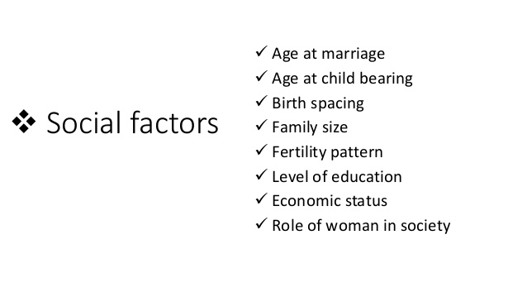

Slide 11
INFECTION
foetal growth retardation, low birth weight, embryopathy, abortion and puerperal sepsis.
Many women are infected with HIV, hepatitis B, cytomegalo viruses,herpes simplex virus or toxoplasma during pregnancy.
25 per cent of the women in rural areas suffer at least one bout of urinary infection.
Children may be ill with debilitating diarrhoeal, respiratory and skin infections for as much as a third of their first year of life.
In some regions, the situation is further aggravated by such chronic infections as malaria and tuberculosis.
The occurrence of multiple and frequent infections may precipitate in the children a severe protein-energy malnutrition and anaemia.
children in developing areas need to be immunized against six infections namely tuberculosis, diphtheria, whooping cough, tetanus, measles and polio.
In India, have adopted the WHO Expanded Programme on Immunization as part of everyday MCH care.
Tetanus toxoid application during pregnancy has also been taken up.
Education of mothers in medical measures such as oral rehydration in diarrhoea and febrile diseases is being tried.
personal hygiene and appropriate sanitation measures, particularly in and around the home, are essential pre-requisites for the control of the most common infections and parasitic diseases.

Slide 14
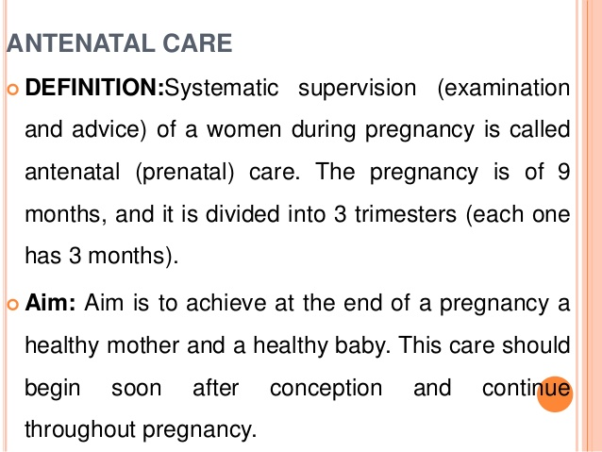

Slide 15
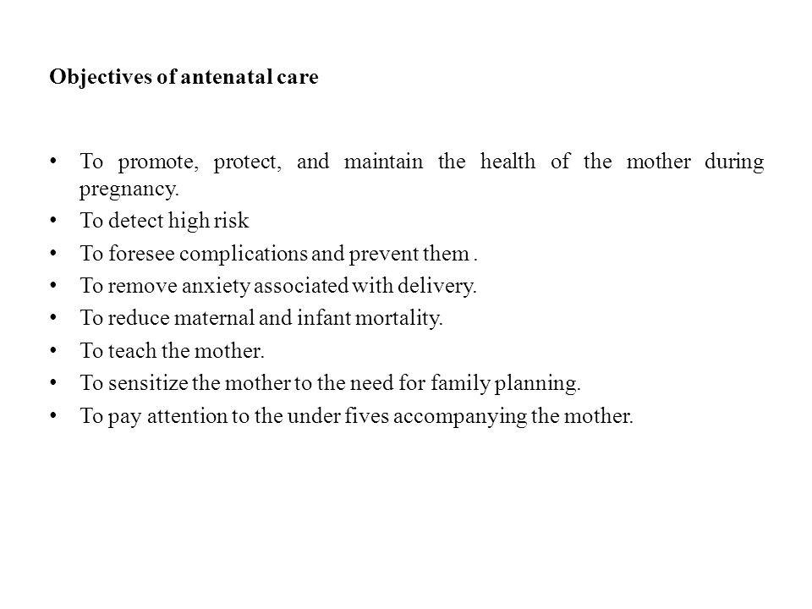
ANTENATAL CARE

Slide 16
PREVENTIVE SERVICES FOR MOTHERS
History-taking
Confirm the pregnancy
Identify whether there were complications during any previous pregnancy
Identify any current medical/ surgical or obstetric condition(s) that may complicate the present pregnancy;
Record the date of 1st day of last menstrual period and calculate the expected date of delivery
Record symptoms indicating complications, e.g. fever, persisting vomiting, abnormal vaginal discharge or bleeding, palpitation, easy fatigability, breathlessness at rest or on mild exertion, generalized swelling in the body, severe headache and blurring of vision, burning in passing urine, decreased or absent foetal movements etc;
History of any current systemic illness, e.g., hypertension, diabetes, heart disease, tuberculosis, renal disease, epilepsy, asthma, jaundice, malaria, reproductive tract infection,· STD, HIV/AIDS etc. Record family history of hypertension, diabetes, tuberculosis, and thalassaemia. Family history of twins or congenital malformation; and
History of drug allergies and habit forming drugs.

Slide 17
Physical examination
I) Pallor : Presence of pallor indicates anaemia. The woman should be examined for pallor at each visit.
Examine woman's conjunctiva, nails, tongue, oral mucosa and palms.
Pallor should be co-related with haemoglobin estimation.

Slide 18
2) Pulse : The normal pulse rate is 60 to 90 beats per minute. If the pulse rate is persistently low or high, with or without other symptoms, the woman needs medical attention.
3) Respiratory rate : It is important to check the respiratory rate, especially if the woman complaints of breathlessness. Normal respiratory rate is 18-20 breaths per minute.
4) Oedema : Oedema (swelling), which appears in the evening and disappears in the morning after a full night's sleep, could be a normal manifestation of pregnancy. Any oedema of the face, hands, abdominal wall and vulva is abnormal If there is oedema in association with high blood pressure, heart disease, anaemia or proteinuria, the woman should be referred to the medical officer.

Slide 19
5. Blood pressure:
Measure the woman's blood pressure at every visit.
Hypertension is diagnosed when two consecutive readings taken four hours or more apart show the systolic blood pressure to be 140 mmHg or more and/or the diastolic blood pressure to be 90 mmHg or more.
Pregnancy-Induced Hypertension (PIH) and/or chronic hypertension.
Check her urine for the presence of albumin.
The presence of albumin ( + 2) together with high blood pressure is sufficient to categorize her as having pre-eclampsia. Refer her to the MO immediately.
If the diastolic blood pressure of the woman is above 110 mmHg, it is a danger sign that points towards imminent eclampsia.
If the woman has high blood pressure but no urine albumin, she should be referred to the MO at 24x7 PHC.
A woman with PIH, pre-eclampsia or imminent eclampsia requires hospitalization and supervised treatment at a 24-hour PHC/FRU.

Slide 20
6) Weight :
A pregnant woman's weight should be taken at each visit.
The ·weight taken during the first visit/ registration should be treated as the baseline weight.
Normally, a woman should gain 9-11 kg during her pregnancy.
Ideally after the first trimester, a pregnant woman gains around 2 kg every month.
She needs to be put on food supplementation for inadequate diet
Low weight gain usually leads to Intrauterine Growth Retardation and results in the birth of a baby with a low birth weight.
Excessive weight gain (more than 3 kg in a month) should raise suspicion of preeclampsia, twins (multiple pregnancy) or diabetes.
Take the woman's blood pressure and test her urine for proteinuria and sugar. If the blood pressure is high and the urine is positive for protein or sugar, refer her to medical officer.

Slide 21
7. Breast examination :
Observe the size and shape of the nipples for the presence of inverted or flat nipples.

Slide 22
Abdominal examination
Measurement of fundal height
Foetal heart sounds
Foetal movements
Foetal parts
Multiple pregnancy
Foetal lie and presentation
Inspection of abdominal scar

Slide 23
1. Measurement of fundal height : Enlargement of the uterus and the height of the uterine fundus
a. 12 weeks - Uterine fundus just palpable per abdomen.
b. 20 weeks - Fundus flat at the lower border of umbilicus
c. 36 weeks- Fundus felt at the level of xiphisternum.

Slide 24
Foetal heart sounds : The foetal heart sounds can be heard after 6th month. The rate varies between 120 to 140 per minute. They are usually best heard in the midline; after the 28th week, their location may change because of the position and lie of the foetus.
Foetal movements : Foetal movements can be felt by the examiner after 18-22nd week by gently palpating the abdomen.
Foetal parts : These can be felt about the 22nd week. After the 28th week, it is possible to distinguish the head, back and limbs.
Multiple pregnancy : This must be suspected if the uterus is larger than the estimated gestational age or palpation of multiple foetal parts.
Foetal lie and presentation : Relevant only after 32 weeks of pregnancy.
Inspection of abdominal scar or any other relevant abdominal findings.

Slide 25
Assessment of gestation age
early ultrasound assessment.
Gestational age assessment based on the date of last menstrual period (LMP)
Alternative approaches to LMP in these settings include fundal height, clinical assessment of the new born after birth or birth weight as a surrogate.

Slide 28
Interventions and counselling
1. Iron and folic acid supplementation and medication as needed
2. Immunization against tetanus
3. Group or individual instruction on nutrition, family planning, self care, delivery and parenthood
4. Home visiting by a female health worker/trained dai.
5. Referral services, where necessary.
6. Inform the woman about Janani Suraksha Yojana and other incentives offered by the government.

Slide 29
RISK APPROACH
1. Elderly primi (30 years and over)
2. Short statured primi (140 cm and below)
3. Malpresentations, viz breech, transverse lie, etc.
4. Antepartum haemorrhage, threatened abortion
5. Pre-eclampsia and eclampsia
6. Anaemia
7. Twins, hydramnios
8. Previous still-birth, intrauterine death, manual removal of placenta
9. Elderly grandmultiparas
10. Prolonged pregnancy (14 days-after expected date of delivery)
11. History of previous caesarean or instrumental delivery
12. Pregnancy associated with general diseases, viz. cardiovascular disease, kidney disease, diabetes, tuberculosis, liver disease etc
13. Treatment for infertility.
14. Three or more spontaneous consecutive abortions.

Slide 30
MAINTENANCE OF RECORDS
A Mother and Child Protection Card should be duly completed for every woman registered.
It contains a registration number, identifying data, previous health history and main health events etc.
The case record should be handed over to the woman.
She should be instructed to bring the record with her during all subsequent check-ups/visits and also to carry it along with her at time of delivery.
This card has been developed jointly by the Ministry of Health and Family Welfare (MOHFW) and Ministry of Women and Child Development (MOWCD) to ensure uniformity in record keeping.
The information contained in the card should also be recorded in the antenatal register as per the Health Management Information System (HMIS) format.

Slide 31
HOME VISITS
must be paid at least one home visit by the Health Worker Female or Public Health Nurse.
More visits are required if the delivery is planned at home.
The mother is generally relaxed at home.
The home visit will win her confidence.
The home visit will provide an opportunity to observe the environmental and social conditions at home and also an opportunity to give prenatal advice.

Slide 33
PERSONAL HYGIENE
Personal cleanliness
Rest and sleep
Bowels
Exercise
Smoking
Alcohol
Dental care
Sexual intercourse

Slide 34
DRUGS :
The use of drugs that are not absolutely essential should be discouraged.
Certain drugs taken by the mother during pregnancy may affect the foetus adversely and cause foetal malformations.
Thalidomide, a hypnotic drug, which caused deformed hands and feet of the babies born.
The drug proved most serious when taken between 4 to 8 weeks of pregnancy.
Other examples are LSD which is known to cause chromosomal damage
Streptomycin which may cause 8th nerve damage and deafness in the foetus
Iodide-containing preparations which may cause congenital goitre in the foetus.
Corticosteroids may impair foetal growth, sex hormones may produce virilism
Tetracyclines may affect the growth of bones and enamel formation of teeth.
Anaesthetic agents including pethidine administered during labour can have depressant effect on the baby and delay the onset of effective respiration.
Later still in the puerperium, if the mother is breast-feeding, there are certain drugs which are excreted in breast milk.

Slide 35
RADIATION
Exposure to radiation is a positive danger to the developing foetus.
The most common source of radiation is abdominal X-ray during pregnancy.
Case cohort studies have shown that mortality rates from leukaemia and other neoplasms were significantly greater among children exposed to intrauterine X-ray.
This is in addition to congenital malformations such as microcephaly.
All women of child-bearing age among whom there is a possibility of pregnancy, elective X-ray should be avoided in the two weeks preceeding the menstrual period.

Slide 36
WARNING SIGNS
(a) swelling of the feet
(b) fits
(c) headache
(d) blurring of the vision
(e) bleeding or discharge per vagina, and
(f) any other unusual symptoms.

Slide 37
CHILD CARE
The art of child care has to be learnt.
Special classes are held for mothers attending antenatal clinics.
Mother-craft education consists of nutrition education, advice on hygiene and childrearing, cooking demonstrations, family planning education, family budgeting, etc.

Slide 40
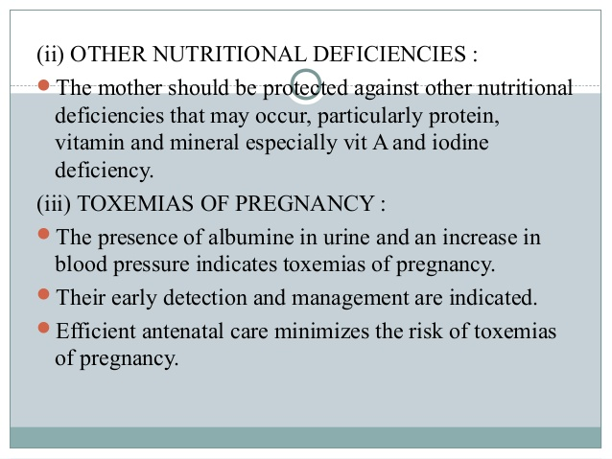

Slide 42
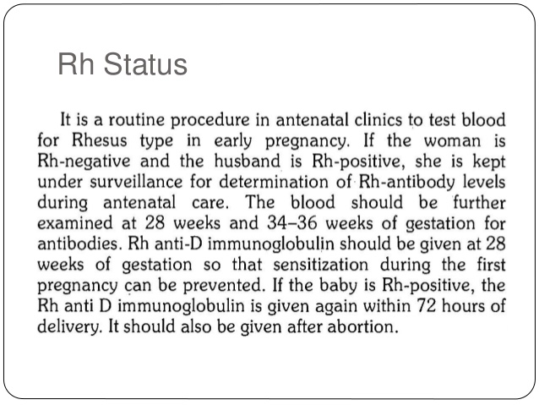

Slide 44
(4) Mental preparation
Mental preparation is as important as physical or material preparation.
Sufficient time and opportunity must be given to the expectant mothers to have a free and frank talk on all aspects of pregnancy and delivery. This will go a long way in removing her fears about confinement.
The "mothercraft“ classes at the MCH Centres help a great deal in achieving this objective.

Slide 45
(5) Family planning
Family planning is related to every phase of the maternity cycle.
The mother is psychologically more receptive to advice on family planning than at other times.
Educational and motivational efforts must be initiated during the antenatal period.
If the mother has had 2 or more children, she should be motivated for puerperal sterilization.
In this connection, the All India Postpartum Programme services are available to all expectant mothers in India

Slide 46
(6) Paediatric component
It is suggested that a paediatrician should be in attendance at all antenatal clinics to pay attention to the under-fives accompanying the mothers.

Slide 55
(2) Anaemia :
Routine haemoglobin examination should
be done.
(3) Nutrition :
Though a malnourished mother is able to secrete as much breast milk as a well nourished one, she does it at the cost of her own health. The nutritional needs of the mother must be adequately met.
(4) Postnatal exercises :
Postnatal exercises are necessary to bring the stretched abdominal and pelvic muscles back to normal as quickly as possible. Gradual resumption of normal house-hold duties may be enough.

Slide 56
PSYSCHOLOGICAL
Fear which is generally borne of ignorance.
Timidity and Insecurity regarding the baby.
If a woman is to endure cheerfully the emotional stresses of childbirth, she requires the support and companionship of her husband.
Fear and insecurity may be eliminated by proper prenatal instruction. The so called postpartum psychosis is perhaps precipitated by birth.

Slide 57
SOCIAL
The really important thing is to nurture and raise the child in a wholesome family atmosphere.
She, with her husband, must develop her own methods.

Slide 58
Breast-feeding
Breast milk provides the main source of nourishment in the first year of life.
When the standard of environmental sanitation is poor and education low, the content of the feeding bottle is likely to be as nutritionally poor as it is bacteriologically dangerous.
It is very important to advise the mothers to avoid the feeding bottle.
A great asset in India is that an average Indian mother, although poor in nutritional status, has a remarkable ability to breast-feed her infant for prolonged periods.
Longitudinal and cross-sectional studies indicate that poor Indian women secrete as much as 400 to 600 ml of milk per day during the first year.
No other food is required to be given until 6 months after birth.
At the age of 6 months, breast milk should be supplemented by additional foods rich in protein and other nutrients (e.g., animal milk, soft-cooked mashed vegetables, etc.). These are called supplementary foods which should be introduced very gradually in small amounts.

Slide 59
FAMILY PLANNING
It has already been stressed that family planning is related to every phase of maternity cycle.
Every attempt should be made to motivate mothers when they attend postnatal clinics or during postnatal contacts to adopt a suitable method for spacing the next birth or for limiting the family size as the case may be.
Postpartum sterilization is generally recommended on the 2nd day after delivery.
Although lactation confers some protection ·against conception, it cannot be depended upon; contraceptives have to be supplied immediately postpartum.
In general, combined or sequential oral "pills" should be avoided in a lactating mother as they do suppress lactation.

Slide 60
Basic health education
Health education during the postnatal period should cover the following broad areas :
(a) hygiene - personal and environmental
(b) feeding for mother and infant
(c) pregnancy spacing
(d) importance of health check-up
(e) birth registration.

